Slide 1

Statistical Privacy for Streaming Traffic
Xiaokuan Zhang¹, Jihun Hamm¹, Michael K. Reiter², Yinqian Zhang¹
¹The Ohio State University
²University of North Carolina at Chapel Hill
Notes:
Hello everyone. I am Xiaokuan from the Ohio State University. Today, I am going to present my paper, ?Statistical privacy for streaming traffic?. This is a joint work with Dr. Jihun Hamm from OSU, Dr. Mike Reiter from UNC chapel hill, and my advisor, Dr. Yinqian Zhang.

Slide 2

Traffic Analysis
Server
Client
Feature
Extraction
Encrypted
packet
sequence
Size of packets,
Timing of packets,
…
Classification
Sensitive info
Notes:
Nowadays when we browse websites, usually the network packets are encrypted to avoid information leakage. However, recent studies have shown that despite of the encryption, sensitive information can still be learned from the encrypted packet sequence using Machine Learning techniques. The traffic analysis attacker can extract certain features from the encrypted packet sequence, such as size and timing of packets, and perform classification on the features to infer sensitive information.

Slide 3
Traffic Analysis --- Video Streaming
Introduction
Attacks on Encrypted Video Streams based on BURST patterns (Schuster et al. Security’17)
Encrypted
packet
sequence
Schuster et al. "Beauty and the burst: Remote identification of encrypted video streams." USENIX Security. 2017.
Notes:
A recent study by Schuster et al. [55] further extended traffic analysis to online video streaming services. They demonstrated that due to the uniqueness of the packet burst patterns of the encrypted video streams, the adversary is able to classify the video with very high accuracy, which is a severe breach to the user?s privacy.

Slide 4
Traffic Analysis --- BURST Patterns
Introduction
MPEG-DASH standard: adaptive bitrate streaming technique
Segments
(video chunks)
Request Next
Segment
Segment1
Segment2
YES
Segment3
Buffer below threshold?
Segment4
Server
Client
Notes:
Let?s look at the BURST pattern they used for the attack. Most of the streaming service providers adopt the MPEG DASH standard, which is an adaptive bitrate streaming technique. In MPEG-DASH, a video is divided into segments. When the client is watching the video, it will only request the next segment when the current buffer is running low, and the entire segment finishes downloading long before the client requests another one.

Slide 5
Traffic Analysis --- BURST Patterns
Introduction
MPEG-DASH standard: adaptive bitrate streaming technique
Segments
(video chunks)
Request Next
Segment
Segment1
Segment2
YES
Segment3
Buffer below threshold?
BURST
in traffic
Segment4
Server
Client
Notes:
The request for new segments cause a unique BURST pattern in the network traffic.

Slide 6
Traffic Analysis --- BURST Patterns
Introduction
Intuition: different videos have different BURST patterns
Notes:
Since different videos have different bitrates, they have different BURST patterns. Here is a simple example of the BURST size of two movies, DIEHARD and FROZEN, when grouping the packets into 50 millisecond windows. It is clear that they are easy to differentiate based on the BURST patterns.

Slide 7
A Motivating Example
Attack Replication
Data Collection
40 videos, 100 traces per video (4000 traces)
Record (timestamp, packet size) of the first 3 mins
Automated using Selenium + Tshark
Notes:
Our goal is to defend against this attack, so we first tried to replicate the attack. We selected 40 videos from Youtube, and collect 100 traces per video. We recorded the timestamp and packet size of the first 3 minutes of video streaming. The data collection process was automated using Selenium and Tshark.

Slide 8
A Motivating Example
Attack Replication
Preprocessing
The raw data (time series) is aggregated into 0.25-second bins
Each 3-minute video stream → array of 720 elements
2500, 4000,
0,
3000,
…
Notes:
The raw data was aggregated into a quarter second bins. Therefore, each 3-minute video stream will be converted into an array of 720 elements. This figure is an illustration of the aggregation process.

Slide 9
A Motivating Example
Attack Replication
5 Classifiers
Support Vector Machine (SVM)
Logistic Regression (LR)
Random Forest (RF)
Neural Net
Convolutional Neural Net (CNN)
Classification Result (5-fold cross-validation)
Notes:
We used 5 types of classifiers to perform the classification. For CNN, we used the exact model as that in the usenix paper. From the result, we can see that CNN performed best with 94.4 percent accuracy. So we successfully replicated their attack using our own dataset.

Slide 10
Traffic Analysis --- Our Work
Introduction
Our work: defense using obfuscation
Obfuscation
Chrome Extension
Encrypted
packet
sequence
Notes:
Our work is to defend against the attack using obfuscation techniques. We used a Chrome extension to enforce the obfuscation. After the defense is deployed, the attacker can still observe the encrypted packet sequence, but he can only achieve baseline accuracy. I am going to explain how this can be done in my presentation.

Slide 11
Outline
Defense 1: Adversarial Machine Learning
Defense 2: Differential Privacy
Evaluation
Real-world Implementation
Discussion
Conclusion
Notes:
Here is the outline. We used two mechanisms for defense, adversarial machine learning and differential privacy. I will introduce each of them, then talk about the evaluation and implementation. After that I will discuss a few issues and conclude my talk.

Slide 12
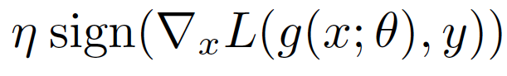
Defense 1: Adversarial ML
Defense 1: Adversarial ML
Defend against ML adversaries
Crafting Adversarial Samples
Fast Gradient Sign Method (FGSM)
Notes:
Our first idea is to adapt adversarial machine learning techniques. Unlike the common use of adversarial ML, we exploit it to construct noised samples to defend against ML adversaries. In particular, we utilize the Fast Gradient Sign Method (FGSM) to generate adversarial samples. Suppose the original video being watched is DIE HARD. By crafting the adversarial samples, the classifier would be confused and would misclassify it as FROZEN.

Slide 13
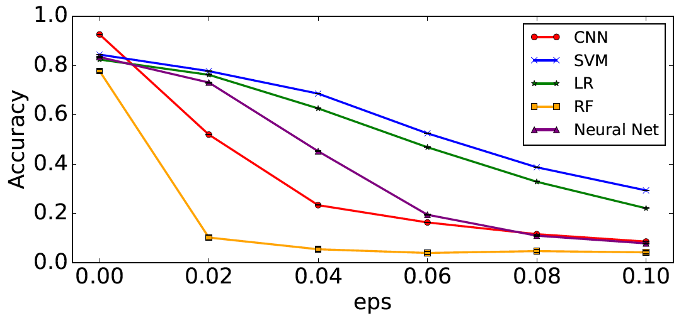
Defense 1: Adversarial ML
Targets the CNN (eps=0.1): 0.944 -> 0.086
Limitations of Adversarial Samples
Not so effective against others!
More principled approach?
Attacker may choose a different classifier
Attacker may conduct adversarial training
(0.086 → 0.908)
Notes:
We targeted the CNN classifier and used the FGSM method to generate the adversarial samples. When the noise level is 0.1, the accuracy drops from 94% to 8.6%. However, there are some limitations of adversarial samples. First, the attacker may choose a different classifier. From this figure, we can see that even though the accuracy of the CNN classifier drops to below 10%, the SVM can still achieve about 40% accuracy, which means that the adversarial samples are not so effective against other type of classifiers. What?s more, the attacker may conduct adversarial training to improve the accuracy. We performed adversarial training on the adversarial samples, and the accuracy increases to over 90\%. That makes us wondering, is there a more principled approach that can effectively defend against different type of ML classifiers?

Slide 14
Outline
Defense 1: Adversarial Machine Learning
Defense 2: Differential Privacy
Evaluation
Real-world Implementation
Discussion
Conclusion
Notes:
So, we use differential privacy as our second defense mechanism.

Slide 15
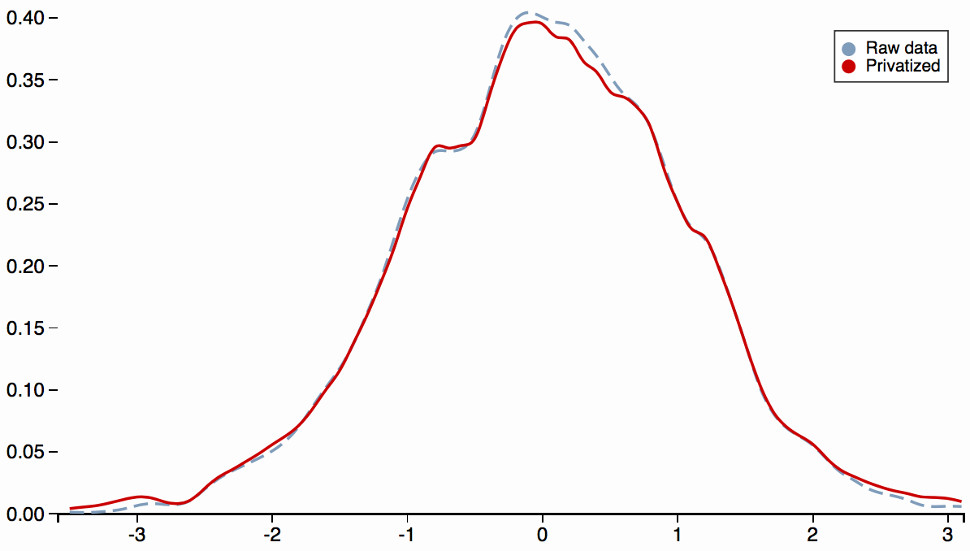
Defense 2: Differential Privacy
Defense 2: Differential Privacy
P(M(D))
Privacy in database
Adding noise with a randomized Alg. M
P(M(D’))
D
Alice
Bob
D’
Bob
Notes:
Differential privacy was originally proposed to protect the privacy in a database. Suppose that we have two adjacent databases, D and D prime, which only differ in one element (D has Alice, D prime does not). A randomized algorithm M achieves differential privacy, if for any observation s, the difference of probability of the result coming from D and D prime is always less than e to the power of epsilon.

Slide 16
Defense 2: Differential Privacy
Defense 2: Differential Privacy
P(M(D))
Privacy in database
Adding noise with a randomized Alg. M
P(M(D’))
D
Alice
Bob
D’
Bob
Notes:
A small epsilon indicates that M(D) and M(D?) will have similar distribution.

Slide 17
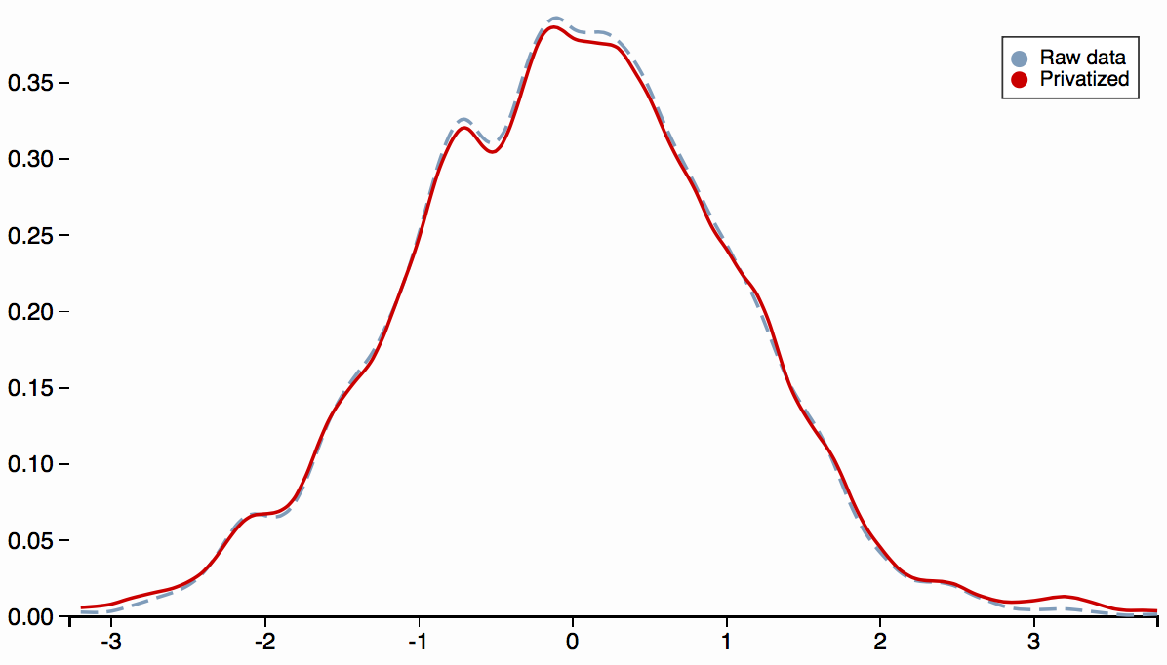
Defense 2: Differential Privacy --- d-privacy
Defense 2: Differential Privacy
P(M(X))
Calculating randomized results from data object
Parameterizing the indistinguishability with distance metric d
P(M(X’))
X
X’
d(X,X’)
Notes:
Cha tzi koko la kis et al. [12] proposed a generalization of differential privacy called d-privacy. It extended the notion of differential privacy to data objects. Suppose that there are two data objects, X and X prime, and a distance metric d. So we have this formula. A randomized algorithm M achieves d privacy, if for any observation s, the difference of probability of the result coming from X and X prime is always less than e to the power of epsilon times the distance between X and X prime.

Slide 18
Defense 2: Differential Privacy --- d-privacy
Defense 2: Differential Privacy
P(M(X))
Calculating randomized results from data object
Parameterizing the indistinguishability with distance metric d
P(M(X’))
X
X’
d(X,X’)
Notes:
A small epsilon and d X, X prime indicates that M(X) and M(X prime) will have similar distribution. In our context, the application of M to sufficiently close examples x and x prime from different classes will ensure that any classifier has a similar probability of classifying M(x) and M(x prime).

Slide 19
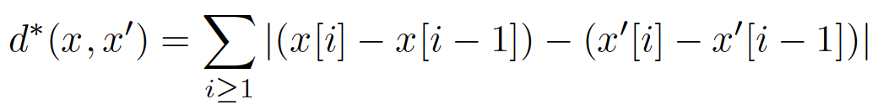
Defense 2: Differential Privacy --- FPA_{k} & d*
Defense 2: Differential Privacy
Fourier Perturbation Algorithm (FPA_{k}): Rastogi et al. (SIGMOD’10)
d*-private Mechanism: Xiao et al. (CCS’15)
Rastogi et al. "Differentially private aggregation of distributed time-series with transformation and encryption." SIGMOD, 2010.
Xiao et al. “Mitigating storage side channels using statistical privacy mechanisms.” CCS, 2015.
Notes:
In our paper, we adopted two mechanisms, Fourier Perturbation Algorithm (FPA) from Rastogi et al. and d star private mechanism from Xiao et al. FPA is epsilon differentially private with certain parameters, and d star is d star, 2-epsilon private. Please refer to the paper for details. Now, let?s look at the data flow with the defense.

Slide 20
Defense 2: Differential Privacy --- data flow
A sequence of original 2-tuples
A: Attacker
D: Defender
D sets window size (w)
Original time series
D adds noise
Noised time series
D emits packets
A sequence of noised 2-tuples
A sets window size (W_{A})
Captured time series
A performs classification
Classification result
Notes:
So we have 2 parties, the attacker A and the defender D. Originally there is a sequence of 2-tuples, timestamp and size. The defender first sets the window size w, and the original 2-tuples will be converted into a time series x. Then, d adds noise to x and generates x tilde (til de). D then emits packets according to x tilde, which is a sequence of noised 2-tuples, and this is what the attacker observes. After that, the attacker sets the window size W A, to convert the packet sequence into an array x dot, then performs classification on x dot to get the result.

Slide 21
Defense 2: Differential Privacy --- data flow
A sequence of original 2-tuples
A: Attacker
D: Defender
D sets window size (w)
Original time series
D adds noise
Noised time series
D emits packets
A sequence of noised 2-tuples
A sets window size (W_{A})
Captured time series
A performs classification
Classification result
Notes:
Note that w and w A can be equal or unequal.

Slide 22
Defense 2: Differential Privacy --- data flow
A sequence of original 2-tuples
A: Attacker
D: Defender
D sets window size (w)
Original time series
D adds noise
Noised time series
D emits packets
A sequence of noised 2-tuples
A sets window size (W_{A})
Captured time series
A performs classification
Classification result
Notes:
Please refer to the paper for details.

Slide 23
Outline
Defense 1: Adversarial Machine Learning
Defense 2: Differential Privacy
Evaluation
Real-world Implementation
Discussion
Conclusion
Notes:
Now let?s go to the evaluation.

Slide 24
Evaluation
Defense 2: Differential Privacy
40x100 traces
Params:
Clip bound for each window: [0, 1GB]
Notes:
We used the 40 video dataset mentioned before, which contains 4000 traces. For parameter settings, we choose 10 epsilons and 5 w s, so we have 50 different pairs in total. Also, for each window, we choose a clip bound of 0 to 1 gigabyte to make sure that the value in each bin is reasonable. Here is a simple example of the clip bound. The blue circles are the data after applying differential privacy.

Slide 25
Evaluation
Defense 2: Differential Privacy
40x100 traces
Params:
Clip bound for each window: [0, 1GB]
Notes:
We examine each value to change values that are less than 0 to 0, and values that are large to 1 gig to 1 gig, as shown in the red circles.

Slide 26
Evaluation
Defense 2: Differential Privacy
40x100 traces
Params:
Clip bound for each window: [0, 1GB]
Notes:
We examine each value to change values that are less than 0 to 0, and values that are large to 1 gig to 1 gig, as shown in the red circles.

Slide 27
Security Evaluation --- FPA_{k}
Defense 2: Differential Privacy
Notes:
Now let's look at the security evaluation. Here I will only talk about the evaluation on FPA for the sake of time. When the attacker and the defender use the same w, the w did not affect the accuracy much.
When epsilon was small, the classification accuracy remained low as w increased.
However, when epsilon was larger, the noise level was low and w played a more significant role.
when epsilon = 50, w = 2s, the classification accuracy went down by about 15%.

Slide 28
Security Evaluation --- FPA_{k}
Defense 2: Differential Privacy
Notes:
To make sure the classifier had a baseline accuracy , FPAk required the epsilon to be less than 0.5.
Next, we study the effect of epsilon. We only show the cases of w = 0:05s and w = 2s, since they were the smallest and largest w values we experimented with

Slide 29
Security Evaluation --- FPA_{k}
W_{A} does not matter
Notes:
We have also considered the scenario where the attacker and the defender chose different w.
We performed similar evaluation on d star, please refer to the paper for details. The takeaway is that with proper parameters the two mechanisms can achieve baseline accuracy; the attacker’s choice of window size does not matter.

Slide 30
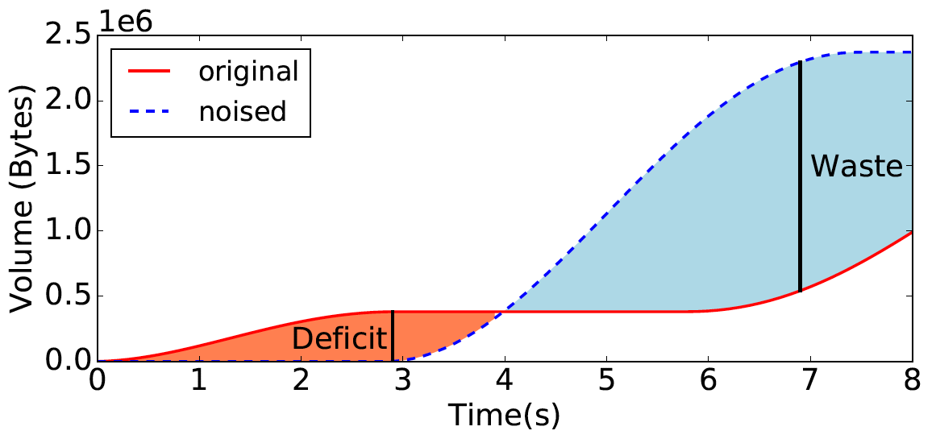
Utility Evaluation
Defense 2: Differential Privacy
Original cumulative trace A, noised cumulative trace B
Waste:
Deficit:
Notes:
Now let?s go to the utility evaluation. Suppose that the original cumulative trace is A, and the noised trace is B. waste means the maximum amount of data that have been downloaded in advance, and deficit means the maximum amount of data that needs to be downloaded to keep streaming. The deficit is the max difference between the two lines in the orange area, while the waste is the max difference in the blue area.

Slide 31
Utility Evaluation --- Waste
FPA_{k}
d*
Notes:
The utility of the two mechanisms was evaluated using the same set of w and epsilon values. According to the figure, parameter w did not affect the waste of the two methods; epsilon was the major factor that affected the waste.

Slide 32
Utility Evaluation --- Deficit
Defense 2: Differential Privacy
FPA_{k}
d*
Notes:
however, the deficit metric followed a different trend. In FPA, deficit was less fluctuated when w and epsilon changed. For d star, changes in either w or epsilon affected the deficit significantly. It was clear that when the w was small (e.g., 0.05s), there was no deficit at all for all epsilon values; when the w was large (e.g., 2s), the deficit could be as large as 0.8MB.

Slide 33
FPA_{k} vs. d*
Defense 2: Differential Privacy
Baseline Accuracy (2.5%)
Lowest Waste
Notes:
To compare FPA and d star, we chose the best parameters for each method, with the baseline accuracy and the lowest waste. These are the parameters we chose for the two methods. The waste and deficit distribution of the 4000 traces after applying the two methods are shown in the figure. We can learn that with the best parameters, FPA traces had a median waste of about 200%, while that of d star traces was even higher (600%).
For deficit, however, d star performed a lot better. More than 80% of dstar traces had a deficit less than 1%, while more than 50 % of FPA traces had at least 5% deficit.

Slide 34
Outline
Defense 1: Adversarial Machine Learning
Defense 2: Differential Privacy
Evaluation
Real-world Implementation
Discussion
Conclusion
Notes:
Now let?s look at our real-world implementation.

Slide 35
Implementation --- Workflow
Defense 2: Differential Privacy
Chrome Extension: change the `range` in the HTTP request (FPA_{k})
A: Client
(Chrome)
B: Chrome
Extension
C: Youtube
Server
Customized
Request
Request
Constant Rate
Response
Response
Notes:
Youtube video streaming implements a variant of MPEG-DASH [40], which allows the client to specify a chunk of video to be downloaded by setting the range parameter. To enforce the privacy guarantee, the Chrome extension use a customized range parameter. There are 3 parties, client, server, and the extension. The attacker is observing traffic between the extension and the server. The client first initializes a request, which is intercepted by the extension. The extension modifies the range of the request, then send this customized request to the server. The received response will be stored in the local storage. The requests will be sent at a constant rate, for example, once per second. Whenever there is a pending request from the client, the extension returns the requested portion from the local storage. In this way, the Youtube packets seen by an external observer are fully controlled by the extension. Since the request pattern from the proxy is differentially private, traffic analysis is not longer effective.

Slide 36
Implementation --- Effectiveness
Defense 2: Differential Privacy
Dataset: 10 videos, 100 traces per video with extension
80% training, 20% test
Settings:
Features:
up/down/total bytes per bin (BPB)
up/down/total packets per bin (PPB)
up/down/total average packet length per bin (LPB)
up/down/total bursts (BURST)
the combination of all 12 features (ALL)
Notes:
To evaluate the effectiveness of our approach, We used the same methods to collect traces for 10 videos, and 100 traces for each video, with our extension enabled. The dataset (1000 traces) was split into a training set with 800 traces and a test set with 200 traces. The traces were collected with w equal to 1s, epsilon equal to 0.5, and we use 5 w A s for evaluation. To demonstrate that the extension can indeed defeat ML-based traffic analysis, we extracted 12 features, such as bytes per bin, and performed classification one by one.

Slide 37
Implementation --- Effectiveness
Defense 2: Differential Privacy
Classification result (CNN)
Notes:
The result of the CNN model is shown in the table. As expected, the CNN model can hardly classify these obfuscated traces. For most cases, the classifier only achieved an accuracy of about 15%.

Slide 38
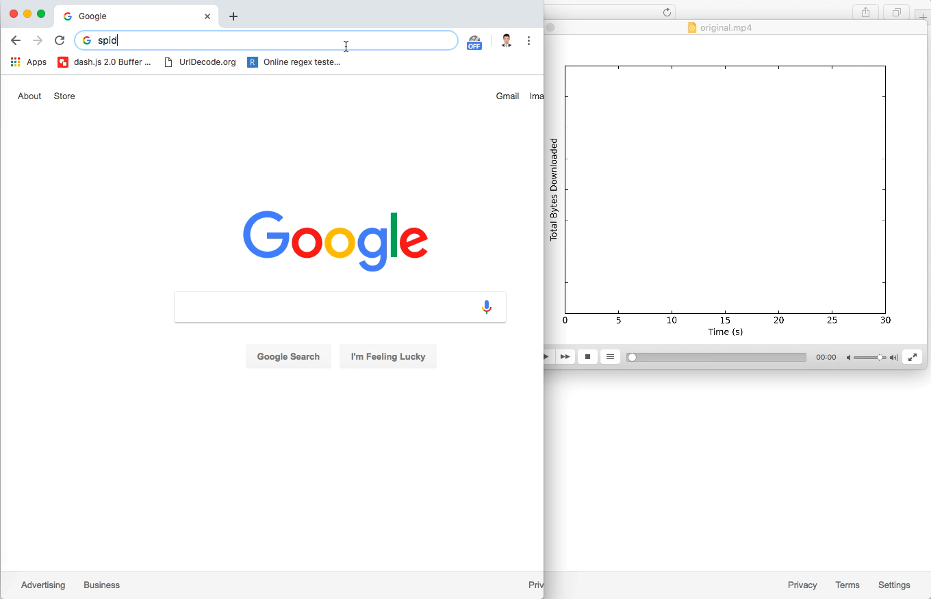
Implementation --- Demo: original
Defense 2: Differential Privacy
Notes:
Now, it is demo time! The user is watching a youtube video without the extension. On the right hand side is a dynamic graph showing the total volume of downloaded packets. We can clearly see the burst patterns from the graph.

Slide 39
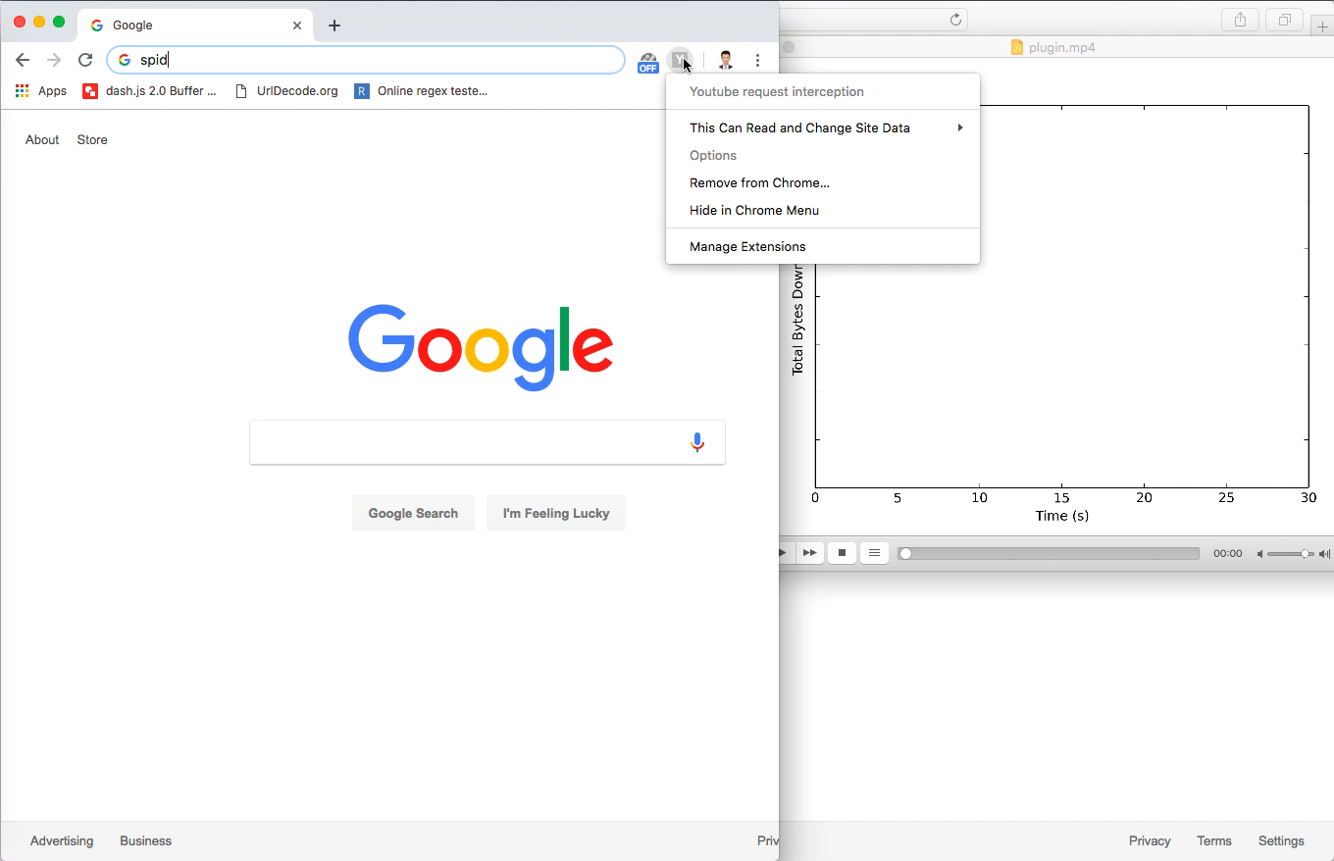
Implementation --- Demo: w. extension
Defense 2: Differential Privacy
Notes:
Next is the demo with extension enabled. We can see that the burst pattern completely changes to one burst every second, which is because we set w to 1 second in the extension. Also, the size of the burst is changing dynamically since they are differentially private.

Slide 40
Outline
Defense 1: Adversarial Machine Learning
Defense 2: Differential Privacy
Evaluation
Real-world Implementation
Discussion
Conclusion
Notes:
Okay. The discussion.

Slide 41
Discussion
Defense 2: Differential Privacy
Reducing waste:
Lowering clip bound (e.g. [0, 1GB] -> [0, 100MB])
Increasing
Notes:
About reducing the waste, there are many ways. We can lower the clip bound to be more realistic, for example, change the upper bound to 100 Megabytes. Also, we may increase the epsilon, which trades the privacy for the utility.

Slide 42
Discussion
Defense 2: Differential Privacy
Leakage through video length
Cannot prevent due to utility loss
Possible solution: grouping the videos by length and padding them to the longest length in each group
Notes:
Our methods do not protect the leakage through video length. Intuitively, to make an 1-minute video indistinguishable from an 1-hour video, considerable amount of noise must be added to hide the difference of the video length. Therefore, in practice, it is more desirable to only make videos with similar length indistinguishable from one another. Grouping the videos by length and padding them to the longest length in each group might be a good solution.

Slide 43
Outline
Defense 1: Adversarial Machine Learning
Defense 2: Differential Privacy
Evaluation
Real-world Implementation
Discussion
Conclusion

Slide 44
Conclusion
Conclusion
We borrowed techniques from adversarial ML and differential privacy to address privacy concerns of streaming traffic
We showed that differential privacy effectively defeats inference-based traffic analysis, while remains agnostic to the ML classifiers
Results suggested that the two differentially private mechanisms offer good security protection with moderate utility loss

Slide 45
Thanks for listening!
Xiaokuan Zhang
zhang.5840@osu.edu
Notes:
Thanks for your attention. I am ready to take questions now.

Slide 46
Backup Slides
Notes:
Thanks for your attention. I am ready to take questions now.

Slide 47
Security Evaluation --- FPA_{k}
Defense 2: Differential Privacy
Notes:
Now let's look at the security evaluation. Here I will only talk about the evaluation on FPA for the sake of time. First, we consider the scenario where the attacker and the defender use the same w. When epsilon was small, the classification accuracy remained low as w increased.

Slide 48
Security Evaluation --- FPA_{k}
Defense 2: Differential Privacy
Notes:
However, when epsilon was larger, the noise level was low and w played a more significant role.
when epsilon = 50, w = 2s, the classification accuracy went down by about 15%.

Slide 49
Security Evaluation --- FPA_{k}
Defense 2: Differential Privacy
Notes:
Next, we study the effect of epsilon. We only show the cases of w = 0:05s and w = 2s, since they were the smallest and largest w values we experimented with. to make sure the classifier had a baseline accuracy , FPAk required the epsilon to be less than 0.5.

Slide 50
Security Evaluation --- FPA_{k}
Notes:
Next, we consider the scenario where the attacker and the defender chose different w. With the same w, when wA increased, the accuracy decreased. Choosing a smaller wA would benefit the adversary. This is because the larger window size used by the adversary during aggregation erased some important features in the data traces.
We have performed similar evaluation on d star, please refer to the paper for details.

Slide 51
Security Evaluation
Defense 2: Differential Privacy
d*

Slide 52
Security Evaluation
Defense 2: Differential Privacy
d*

Slide 53
Security Evaluation
d*: w = 0.05s
d*: w = 2s

Slide 54
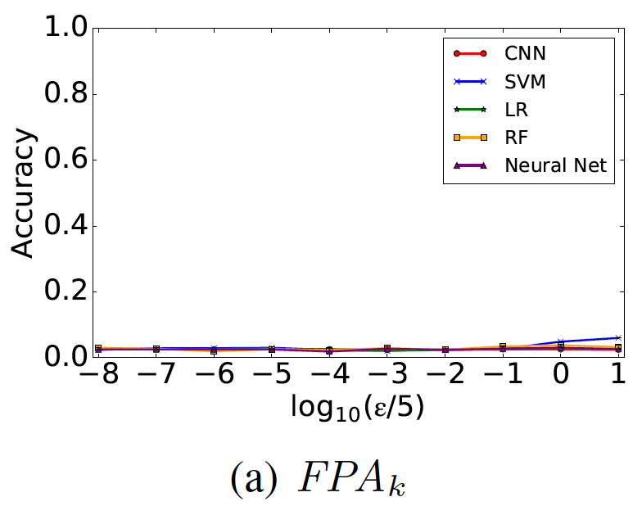
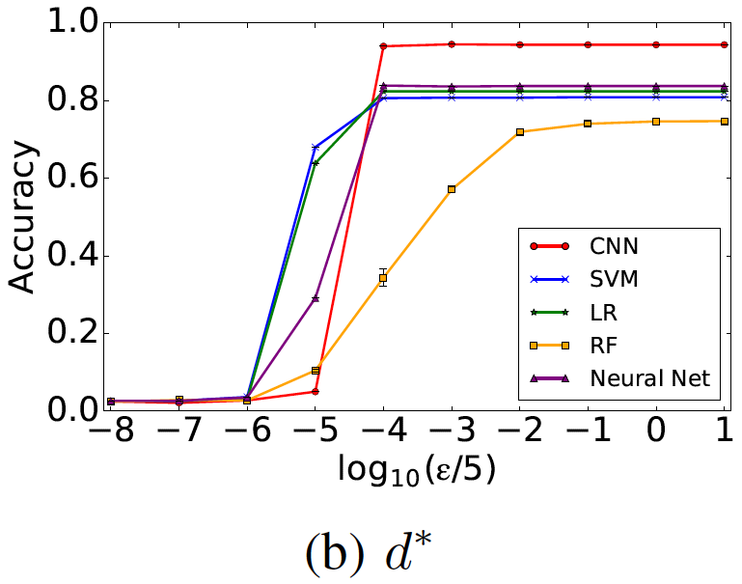
Security Evaluation --- Train w. clean, test w. noised
Defense 2: Differential Privacy

Slide 55
Baseline Approach
Defense 2: Differential Privacy
Window size: w seconds
Max value of all bins of all videos (4000 traces): C
Baseline defense mechanism: C bytes per w seconds (all videos)
Notes:
from the attacker’s perspective, all video streams were identical, and no deficit would be incurred for the noised video.
The waste induced by FPAk is at least one order of magnitude lower than the baseline approach.

Slide 56
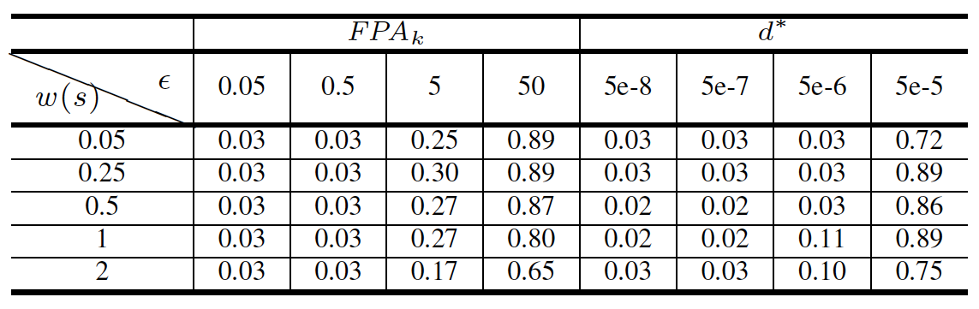
Optimal Attacker
Defense 2: Differential Privacy
The Attacker has the knowledge of distribution of both clean data and noised data (but not the mapping between the two)
First try to remove noise, then perform classification
Improvement of accuracy:
Naldi et al. “Differential privacy for counting queries: can bayes estimation help uncover the true value?”, arXiv:1407.0116.
Notes:
add paper citation

Slide 57
Implementation --- Workflow
Defense 2: Differential Privacy
Chrome Extension: change the byte range in the HTTP request
A sends a request
with a byte range
B fires requests
at a constant rate
A: Client
(Chrome)
B: Chrome
Extension
C: Server
B returns requested
portion from local storage
C sends responses back,
B stores responses locally
Notes:
Add animation to show that AB comm. and BC comm. are decoupled, not one-one mapping

Slide 58
Discussion
Defense 2: Differential Privacy
Comparing FPA_{k} with d*
Accuracy ←→ Security Guarantee
FPA_{k} requires the knowledge of the entire time series

